Slide 1
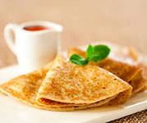
Pancakes
cookingmaster-class
Duyun V.A.

Slide 2
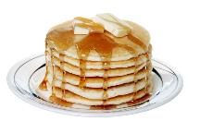
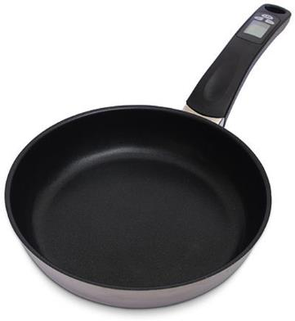
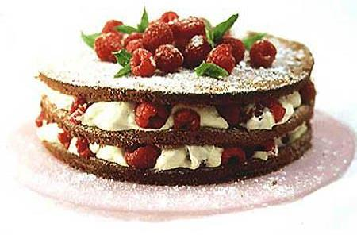
Pan
cake

Slide 3
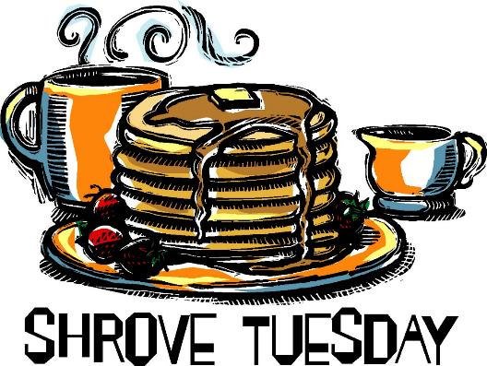
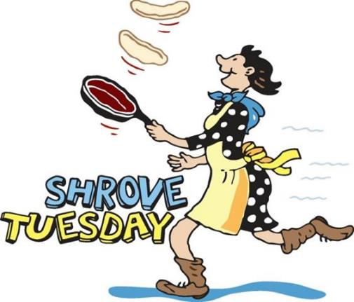
Pancake Day in the UK is also known as Shrove Tuesday.This year it is on 4th March (2014)
It is traditionally a day of fun and
feasting before 40 days of Lent.
Fun- веселье
Feast –пир
Lent- пост

Slide 4
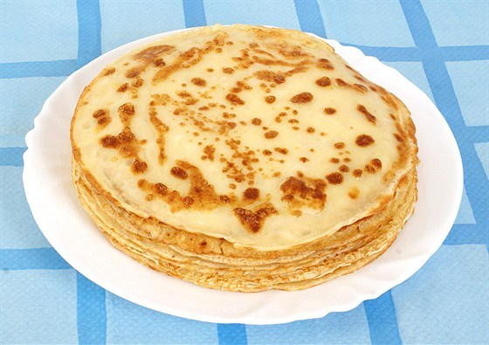
How to cook
pancakes?

Slide 5
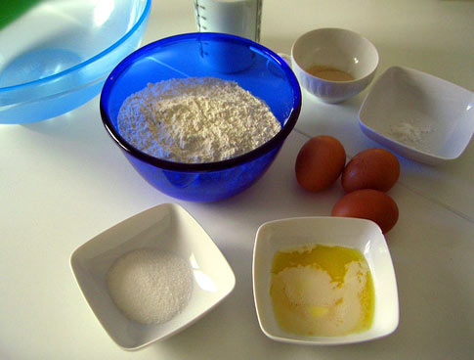
Ingredients:

Slide 6
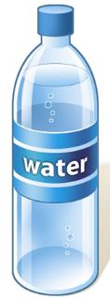
milk
oil
flour
soda
salt
eggs
vinegar
sugar
butter

Slide 7
Let's practice a little!

Slide 8
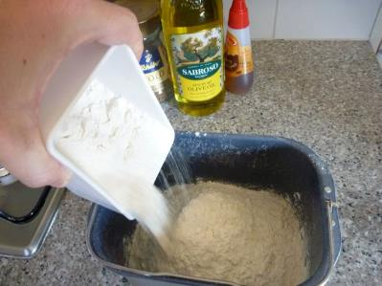
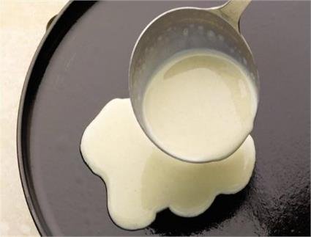
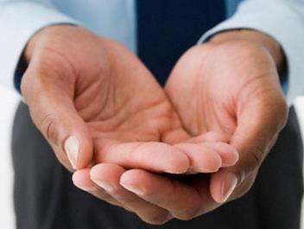
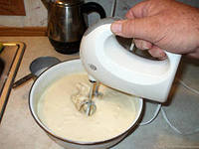
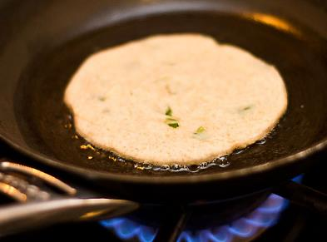
Pour
Add
Take
Mix
Fry

Slide 9
Let’s play “Toss and catch a pancake”
Toss - кидать catch- ловить

Slide 10
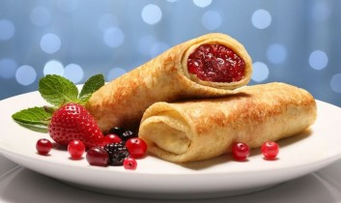
Enjoy your meal!

